Slide 1
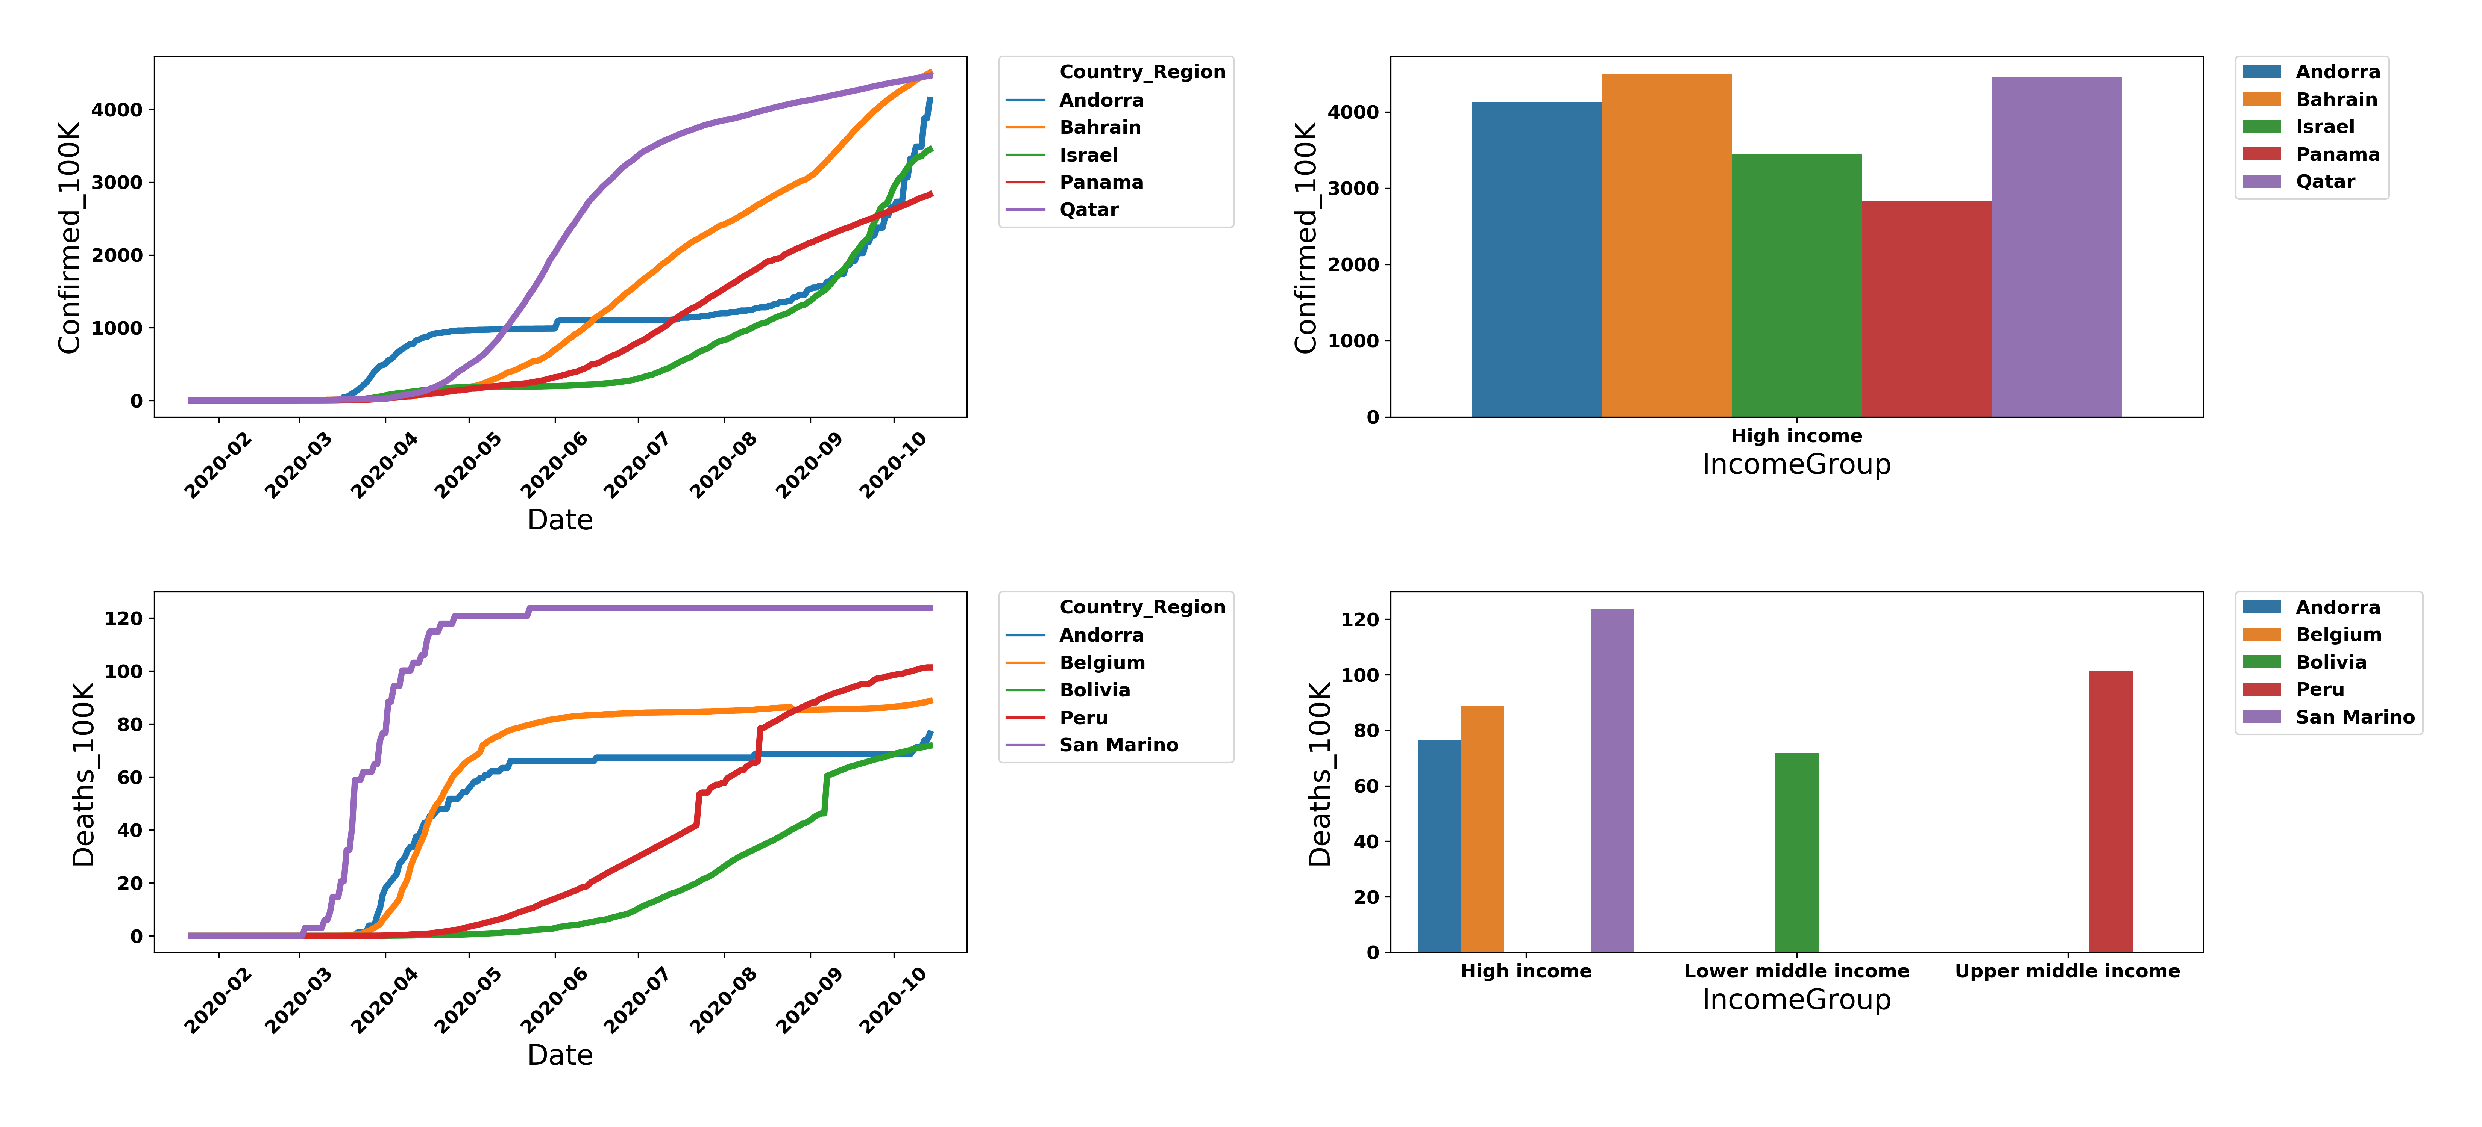
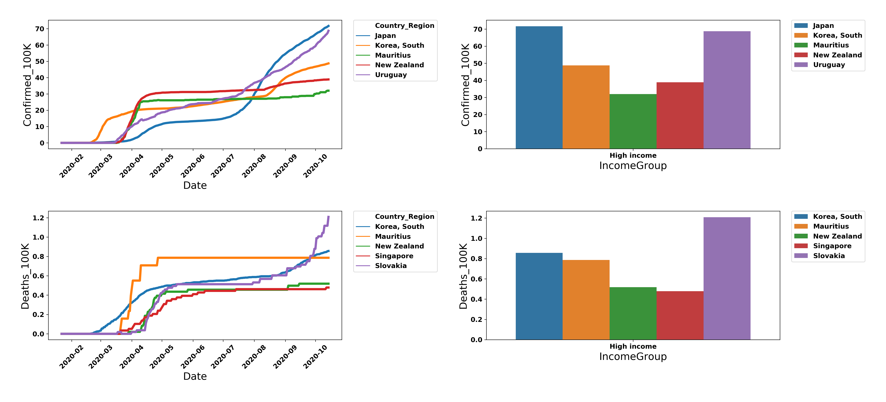
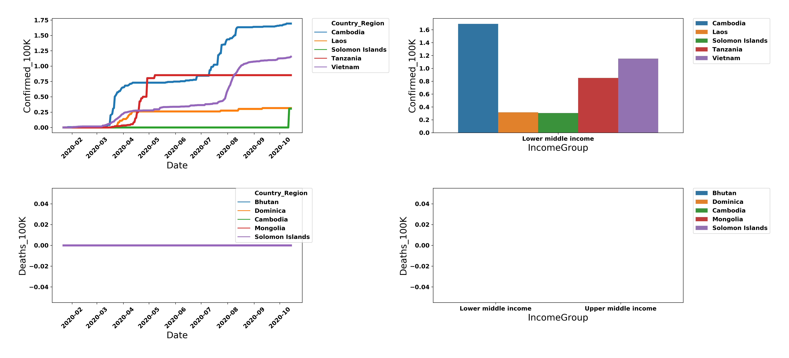
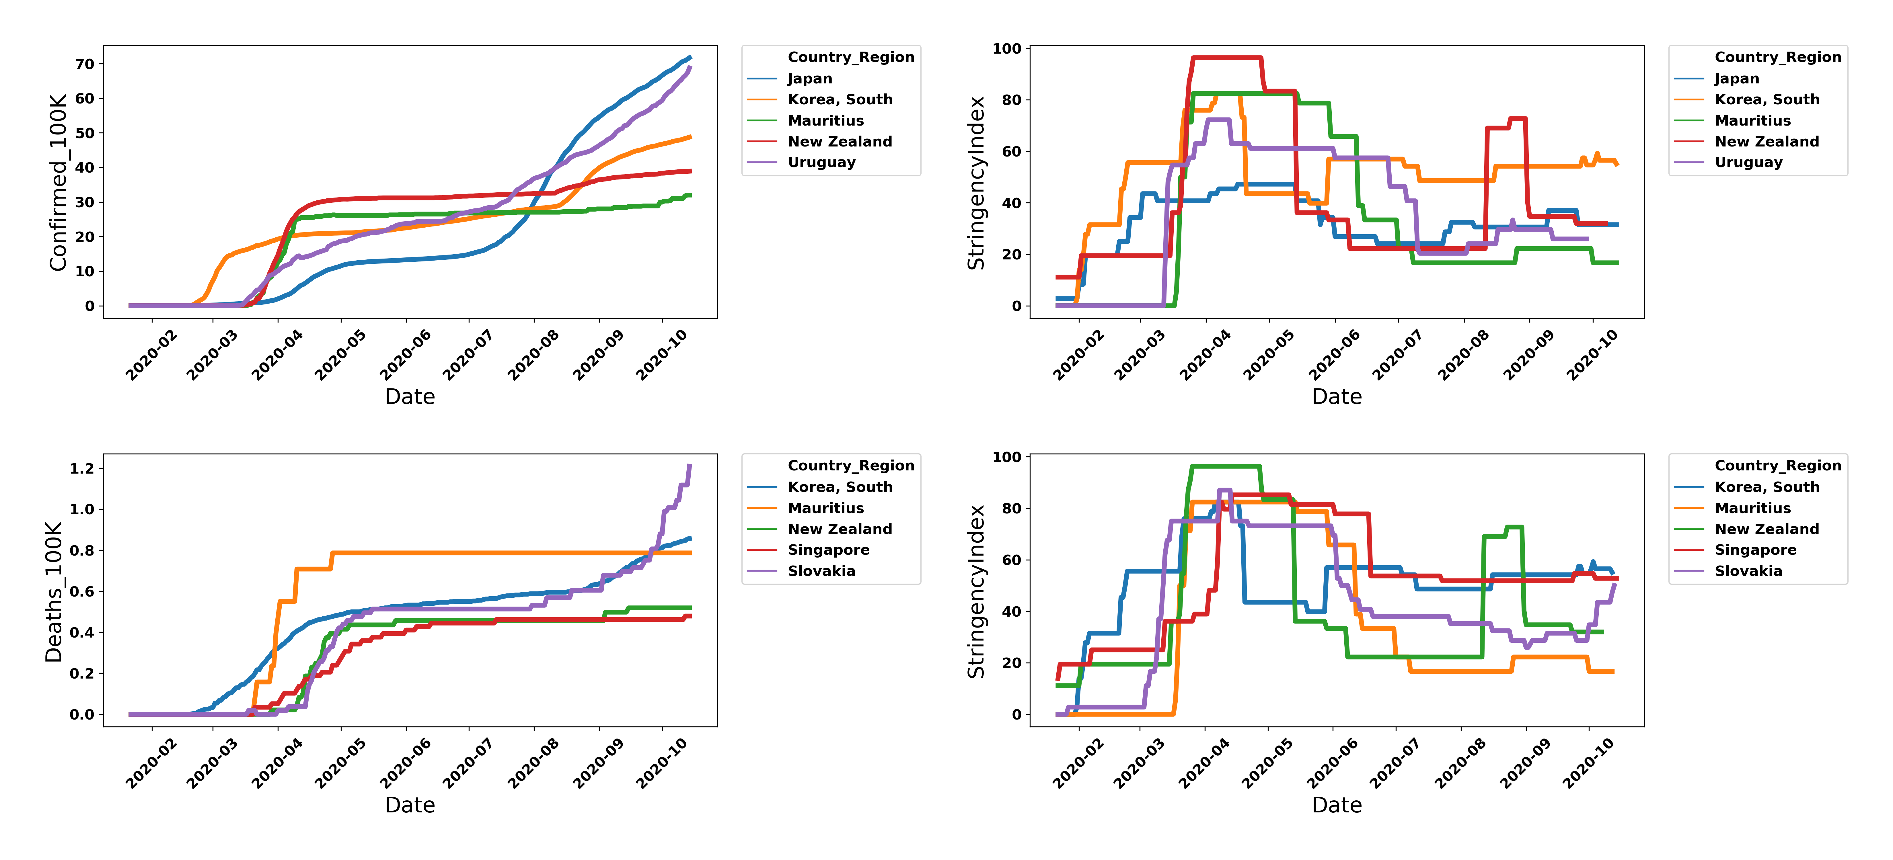
Government strategies in containing the pandemic outbreak
Andrea Camacho, Ruben Lopez
Background
Methods
Figure 1. Data acquisition and processing workflow. We create a new relational dataset by combining the databases from COVID infections, stringency index and socioeconomic indicators from thrustful and recognized online sources. The new database is an enriched dataframe with relevant information that facilitates our further analysis.
Findings
Most affected countries with Covid and their income level
Less affected countries (reported) with Covid and their income level
Less affected countries with Covid and their income level
Conclusions
Bla blabla

